Slide 1


Retail Analytics
Using the past to plan for the future
Robert K Burns
DSC680
December 15, 2019

Slide 2
Why preform retail data analysis?
Improve customer experience
Improve efficiency
Better Advertising
Forecast trends
The list goes on and on

Slide 3

What factors are important?
What information are we gathering?
How are we getting this information?
How are we using it?

Slide 4
Who are we observing?
Customers
Potential customers
Suppliers
Employees

Slide 5
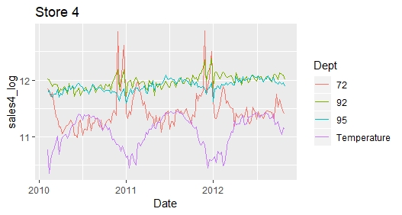
How the weather changes retail
Accessibility
Product need
Supply chain

Slide 6
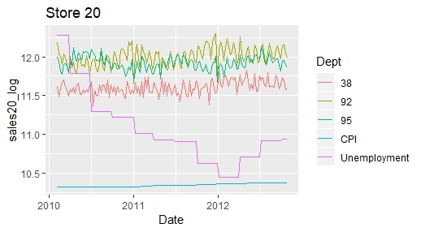
Unemployment’s effects on retail
Some effects
Based on need

Slide 7
Great, so what do we do with this?
Understand impacts
Plan accordingly
Prepare for the future

Slide 8

Any questions?
www.github.com/kirbyeburns/DSC680_Project_1_Retail_Analytics

